Slide 1
Wireless Sensor Network In Environment Monitoring
SlideMake.com

Slide 2
Introduction
Wireless sensor networks (WSNs) are an innovative solution for environment monitoring.
WSNs consist of numerous small sensors that collect data and transmit it wirelessly.
These networks provide real-time information, enabling effective monitoring and management of the environment.
1
Notes:
Image source: https://www.researchgate.net/figure/The-general-architecture-of-Wireless-Sensor-Networks-WSNs-Sensor-Nodes-Sink-Nodes-a_fig1_344701127

Slide 3
Advantages of WSNs in Environment Monitoring
WSNs provide continuous monitoring without human intervention, allowing for more accurate data collection.
They offer a cost-effective solution compared to traditional monitoring methods.
WSNs can cover large areas, providing extensive coverage for environmental monitoring.
2
Notes:
Image source: https://www.researchgate.net/figure/The-conceptual-diagram-of-the-WSN-based-environmental-monitoring-system-deployed-in-an_fig1_299592363

Slide 4
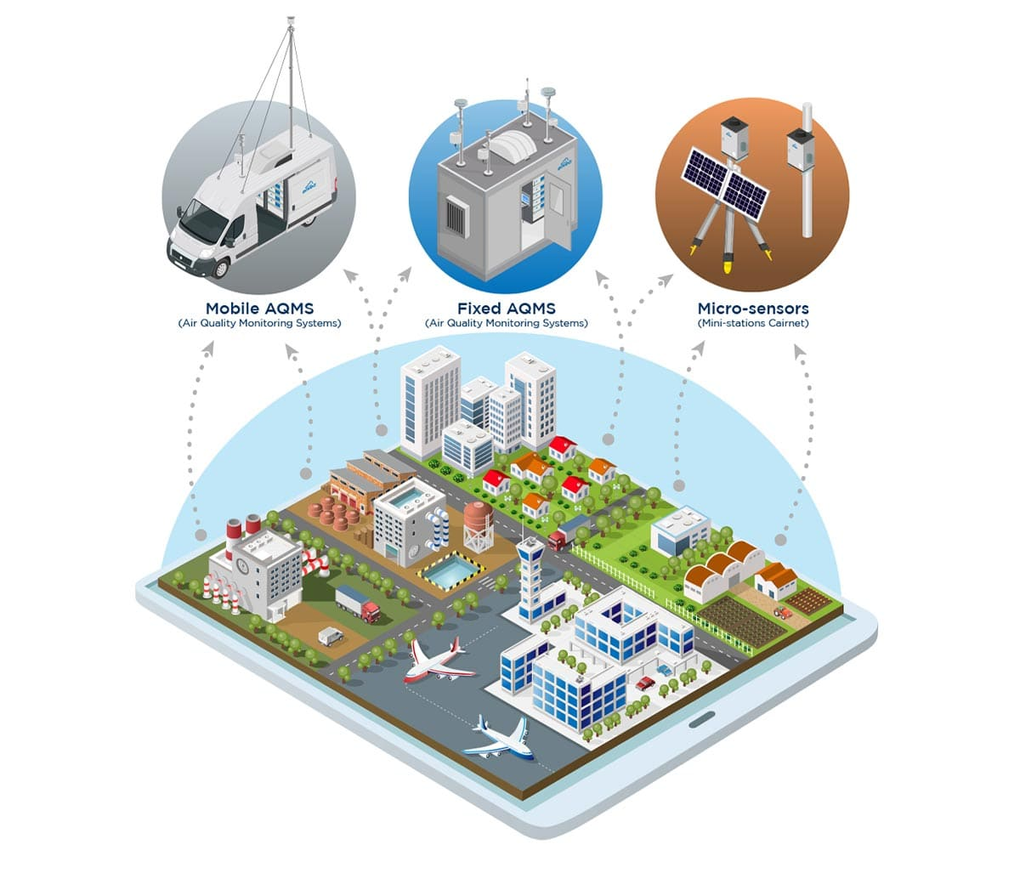
Applications of WSNs in Air Quality Monitoring
WSNs can measure various air pollutants such as particulate matter, gases, and volatile organic compounds.
They enable real-time monitoring of air quality, helping to identify pollution sources and assess their impact.
WSNs provide valuable data for planning and implementing air pollution control measures.
3
Notes:
Image source: https://www.envea.global/solutions/ambient-monitoring/air-quality-monitoring/

Slide 5
Applications of WSNs in Water Quality Monitoring
WSNs can monitor various water parameters like temperature, pH, dissolved oxygen, and pollutants.
They enable continuous monitoring of water bodies, ensuring early detection of pollution events.
WSNs help in assessing the impact of human activities on water quality and supporting effective management strategies.
4
Notes:
Image source: https://www.researchgate.net/figure/WSNs-for-water-quality-monitoring_fig2_335207701

Slide 6
Applications of WSNs in Forest Fire Detection
WSNs can detect and monitor forest fires by measuring temperature, humidity, and smoke levels.
They provide early warning systems, allowing for timely fire response and mitigation.
WSNs aid in reducing the damage caused by forest fires and protecting ecosystems.
5
Notes:
Image source: https://www.researchgate.net/figure/The-proposed-architecture-for-forest-fire-detection_fig1_305773926

Slide 7
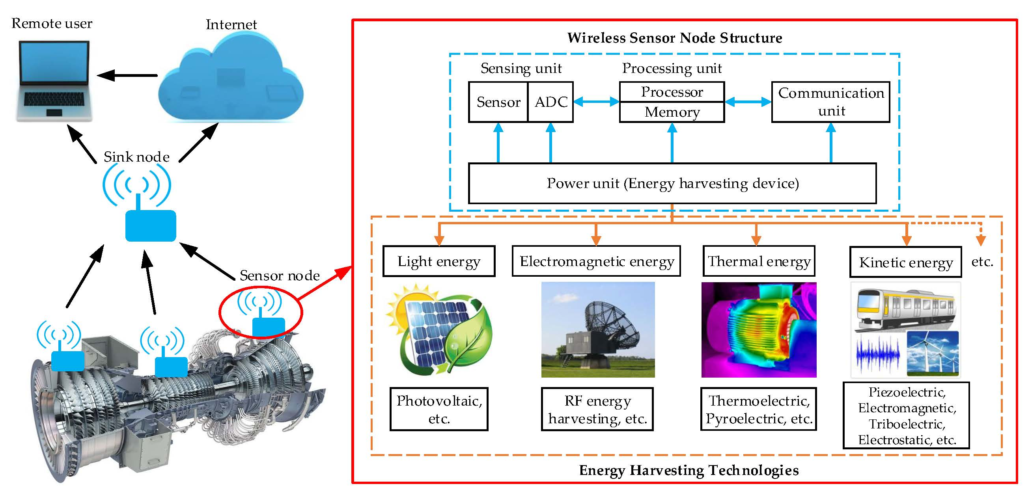
Challenges in WSNs for Environment Monitoring
Limited power supply is a challenge as sensor nodes rely on batteries or energy harvesting techniques.
Data fusion and processing in a distributed manner can be complex due to the large amount of data generated by sensor nodes.
Ensuring secure and reliable communication in WSNs is crucial to prevent data tampering or unauthorized access.
6
Notes:
Image source: https://www.mdpi.com/1424-8220/18/12/4113

Slide 8
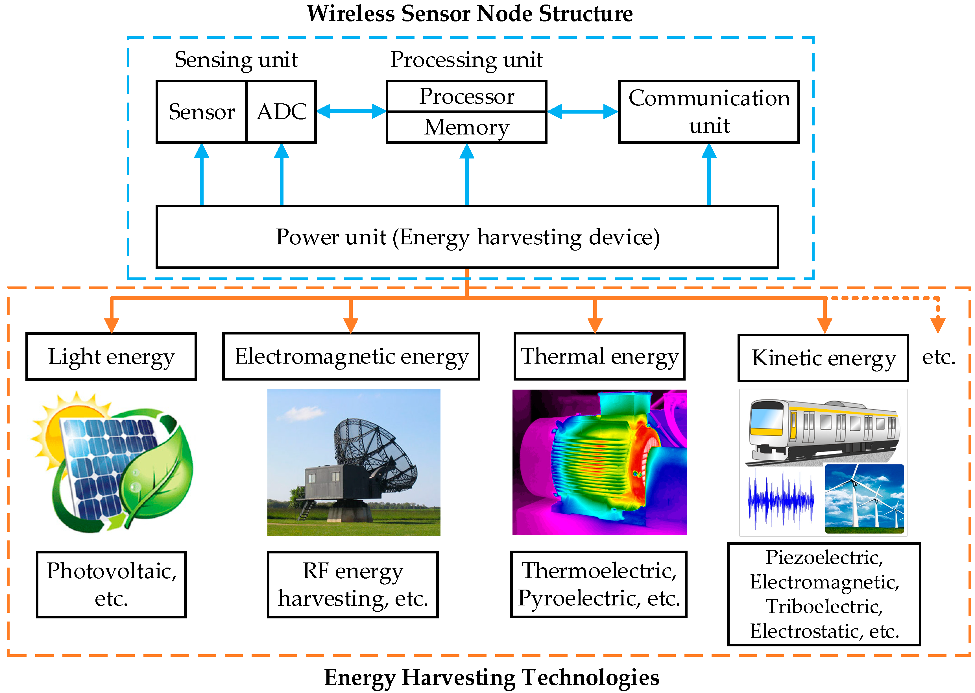
Future Developments in WSNs for Environment Monitoring
Advancements in energy harvesting techniques will enhance the autonomy of sensor nodes.
Integration of artificial intelligence and machine learning algorithms will enable intelligent data processing and decision-making.
The use of drones in conjunction with WSNs will provide a more comprehensive and dynamic monitoring solution.
7
Notes:
Image source: https://www.mdpi.com/1424-8220/18/12/4113

Slide 9

Case Study: Great Barrier Reef Monitoring
WSNs are used to monitor water quality, temperature, and the health of coral reefs in the Great Barrier Reef.
Real-time data from WSNs helps in understanding the impact of climate change and human activities on the reef ecosystem.
WSNs assist in designing targeted conservation efforts and preserving this valuable natural heritage.
8
Notes:
Image source: https://reef-world.org/reef-monitoring

Slide 10
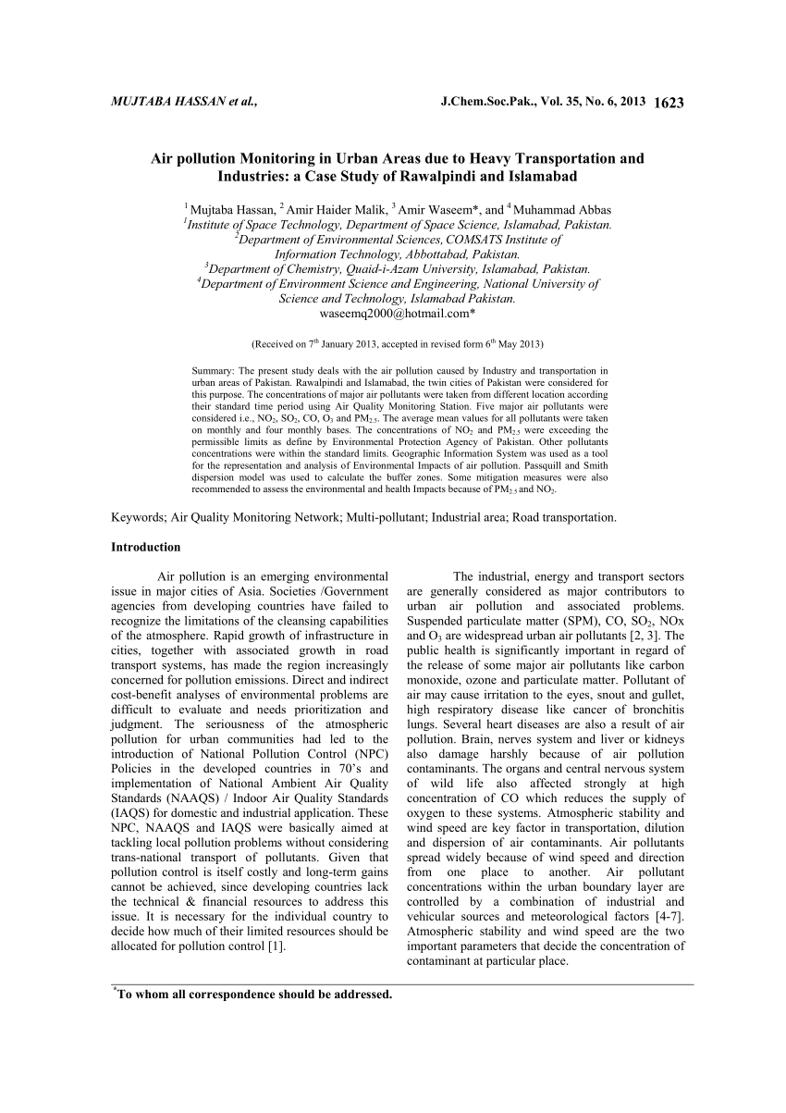
Case Study: Air Pollution Monitoring in Urban Areas
WSNs are deployed in urban areas to monitor air quality and identify pollution hotspots.
Real-time data from WSNs helps in implementing effective air pollution control measures.
WSNs aid in promoting public awareness and engagement for sustainable urban development.
9
Notes:
Image source: https://www.researchgate.net/publication/262260388_Air_pollution_Monitoring_in_Urban_Areas_due_to_Heavy_Transportation_and_Industries_a_Case_Study_of_Rawalpindi_and_Islamabad

Slide 11
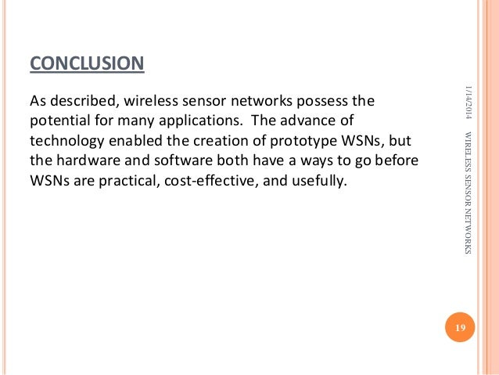
Conclusion
Wireless sensor networks play a vital role in environment monitoring, providing real-time data for effective management.
WSNs have numerous applications in air quality, water quality, and forest fire monitoring.
Future developments will further enhance the capabilities of WSNs in environmental monitoring.
10
Notes:
Image source: https://www.slideshare.net/karthikadabala7/wireless-sensor-networks-30029646

Slide 12
References
Smith, A. (2019). Wireless Sensor Networks for Environmental Monitoring. International Journal of Environmental Research and Public Health, 16(9), 1658.
Rajasegarar, S., Leckie, C., & Palaniswami, M. (2010). Data Mining for Wireless Sensor Networks: Applications, Challenges, and Future Directions. ACM Transactions on Sensor Networks, 6(2), 11.
Ghasem, N., & Saeed, F. (2016). Wireless Sensor Networks for Environment Monitoring: A Review. International Journal of Distributed Sensor Networks, 12(5), 1-15.
11

